Slide 1
Ansible

Slide 2
What are you going to learn in this session ?
Following are the topics to be discussed:
What is Ansible ?
How to install and configure Ansible ?
Setup Trust between hosts
Inventory File
Modules
Adhoc Commands
Playbooks
Handlers
Roles
Variables
Conditional statements
Loops
Advance Use cases

Slide 3
What is ansible ?
What is Ansible ?
Ansible is an IT automation tool. It can configure systems, deploy software, and orchestrate more advanced IT tasks such as continuous deployments or zero downtime rolling updates.
Use Cases:
Updating OS on machines in a Data Center
Deploying an application
Configuration management
Apply a fix pack on all the machines in a Data Center
Restart all the web/App Server sequentially
OS Supported ?
Red Hat Linux
Debian
CentOS
OS X
Ubuntu
any of the BSD’s
macOS
Windows
Ansible pre-requisites & limitations?
Control Machine
Machine where Ansible jobs get triggered from
With help of this machine rest of the Managed nodes can be controlled
Managed Node
Any machine which requires changes or get managed
Pre-requisites for machines:
Python 2 (versions 2.6 or 2.7) or Python 3 (versions 3.5 and higher)
Windows machine is not supported as control machine.

Slide 4
Install & Configure Ansible

Slide 5
How to install and configure Ansible ?
Installing Ansible
Control Machine
ansible binary need to be installed
Instructions varies for Operating Systems
Installation instructions are available in the article
Managed Node
No installation is required. These nodes should have Python 2 (versions 2.6 or 2.7) or Python 3 (versions 3.5 and higher)
On the managed nodes, you need a way to communicate, which is normally ssh. By default this uses sftp.
Upgrading Ansible
Upgrading Ansible just requires updating ansible binary on the Control machine.
Changes to the playbooks are required, if the playbooks are using any deprecated packages
Configuring Ansible
Can customize how ansible should work with help of
ansible.cfg file
Environment variables
Command line options
ansible-config utility can be used to configure ansible

Slide 6
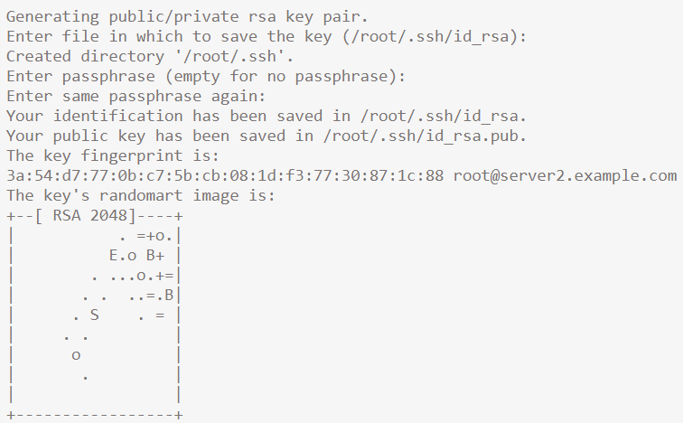
Setup Trust between hosts
On Control Machine
login with user id – trust setup is required for (Lets assume user as root)
Creating Key Pair
ssh-keygen -t rsa
/root/.ssh/id_rsa.pub
/root/.ssh/id_rsa
Authorizing the server to trust itself
cat /root/.ssh/id_rsa.pub >> /root/.ssh/authorized_keys

Slide 7
Setup Trust between hosts
On Managed node
Copy /root/.ssh/id_rsa.pub from “Control Machine” to “Managed Node”
switch to the user home directory – to setup trust for (lets assume user as root)
cd /root/
cd .ssh
Add “Control Machine” public key to “ssh/authorized_keys” file.
cat /root/.ssh/id_rsa.pub >> /root/.ssh/authorized_keys

Slide 8
Inventory

Slide 9
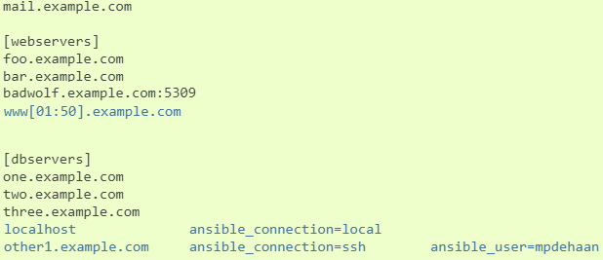
Working with Inventory
Inventory File
Ansible works against multiple systems in your infrastructure at the same time.
It does this by selecting portions of systems listed in Ansible’s inventory
Default inventory file is /etc/ansible/hosts
Contains
Hosts & Groups
Variables
1) Hosts & Groups

Slide 10

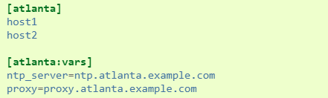
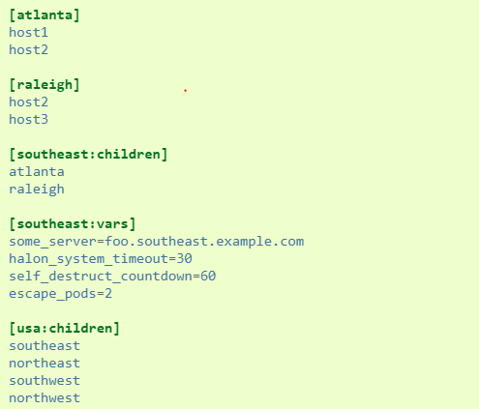
Working with Inventory
Hosts & Groups
Host Variables
Group Variables
Groups of Groups, and Group Variables

Slide 11



Working with Inventory
Default Groups
all
ungrouped
Splitting Out Host and Group Specific Data
host and group variables can be stored in individual files relative to the inventory file
Ex: If inventory file is, /etc/ansible/hosts
File: /etc/ansible/group_vars/raleigh
You can create directories named after your groups or hosts, and Ansible will read all the files in these directories in lexicographical order
* The group_vars/ and host_vars/ directories can exist in the playbook directory OR the inventory directory. If both paths exist, variables in the playbook directory will override variables set in the inventory directory.

Slide 12
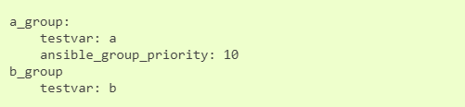
Working with Inventory
How Variables Are Merged ?
By default variables are merged/flattened to the specific host before a play is run
Order of precedence is (from lowest to highest)
all group (because it is the ‘parent’ of all other groups)
parent group
child group
host
When groups of the same parent/child level are merged, it is done alphabetically, and the last group loaded overwrites the previous groups
Order of precedence is (from lowest to highest)
Group variable ansible_group_priority to change the merge order for groups of the same level. The larger the number, the later it will be merged, giving it higher priority
List of Behavioral Inventory Parameters
https://docs.ansible.com/ansible/latest/user_guide/intro_inventory.html#id12

Slide 13
Modules

Slide 14
Modules
What is a Module ?
Modules (also referred to as “task plugins” or “library plugins”) are discrete units of code that can be used
from the command line or in a playbook task.
Modules are the one does actual job on the “Managed Nodes”
Return Values
rc
stdout
changed
https://docs.ansible.com/ansible/latest/reference_appendices/common_return_values.html

Slide 15
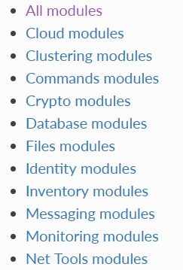
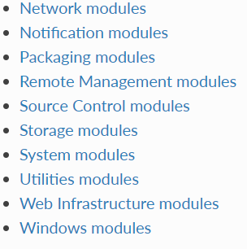
Modules
Module Maintenance & Support
Core
Network
Certified
Community
https://access.redhat.com/articles/3166901
Modules

Slide 16
Adhoc Commands

Slide 17
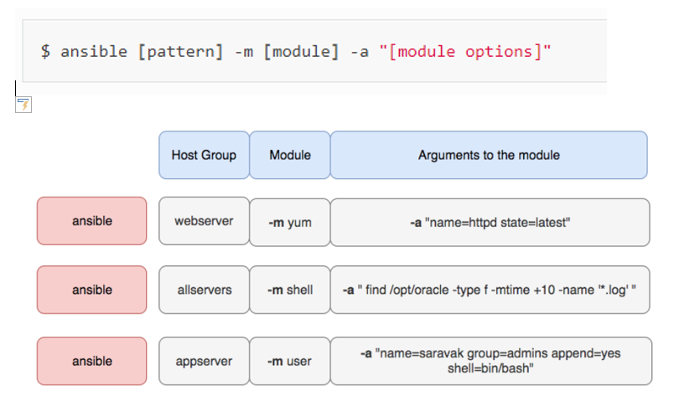
Adhoc Commands

Slide 18
Adhoc Commands
What’s an ad-hoc command?
An ad-hoc command is something that you might type in to do something really quick, but don’t
want to save for later.
Run the command to reboot all servers in a group, in this case, atlanta, in 10 parallel forks
ansible will default to running from your user account. If you do not like this behavior, pass in “-u username”
Often you’ll not want to just do things from your user account. If you want to run commands through privilege
escalation (root)
It is also possible to become a user other than root using --become-user
Using the shell module looks like this

Slide 19
Adhoc Commands
To transfer a file directly to many servers
The file module allows changing ownership and permissions on files
The file module can also create directories, similar to mkdir -p
As well as delete directories (recursively) and delete files
Ensure a package is installed, but don’t update it
Ensure a package is installed to a specific version
Ensure a package is at the latest version

Slide 20


Adhoc Commands
Ensure a package is not installed
The ‘user’ module allows easy creation and manipulation of existing user accounts, as well as removal of user accounts that may exist:
Ensure a service is started on all webservers
Restart a service on all webservers
Ensure a service is stopped
Long running operations can be run in the background
Gathering facts

Slide 21
Playbooks

Slide 22
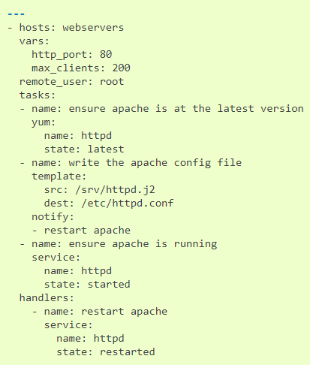
Playbooks
Playbooks are a completely different way to use ansible than in adhoc task execution mode
Playbooks are the basis for a really simple configuration management and multi-machine deployment
system. They can launch tasks synchronously or asynchronously.
Playbooks are expressed in YAML format
Playbook contains one or more plays, each play contains one or more tasks
A task is nothing more than a call to an ansible module
Sample Playbook: (One Play)

Slide 23
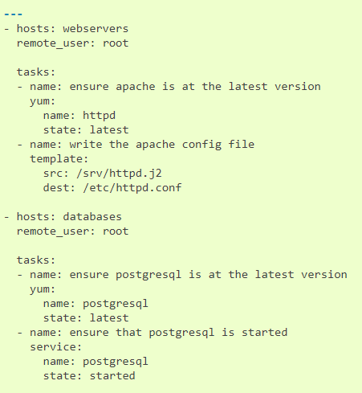
Playbooks
Sample Playbook: (Two Plays)

Slide 24
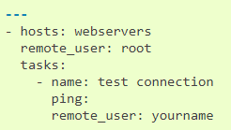
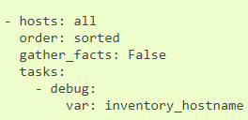
Playbooks
Remote users can also be defined per task
You can also control the order in which hosts are run. The default is to follow the order supplied by the inventory
inventory
reverse_inventory
sorted
reverse_sorted:
shuffle

Slide 25
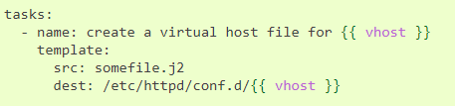
Playbooks
Variables can be used in action lines
How to run a playbook ?
# ansible-playbook playbook.yml –f 10
# ansible-playbook –i /tmp/hosts playbook.yaml
Check what hosts would be effected with a playbook
Check the syntax of a playbook
To check syntaxt of the playbook, use ‘--syntax-check’ flag.

Slide 26
Handlers

Slide 27
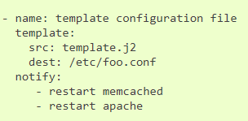
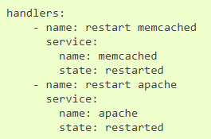
Handlers
“Handlers”, Running operation on a change
“notify” actions are triggered at the end of each block of tasks in a play
Restarting two services when the contents of a file change, but only if the file changes
handlers
Ex: 1

Slide 28
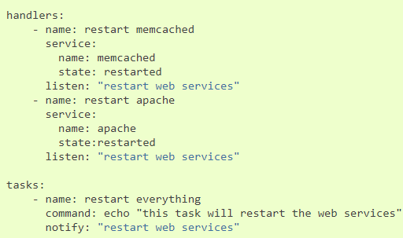
Handlers
Ex: 2

Slide 29
Roles

Slide 30
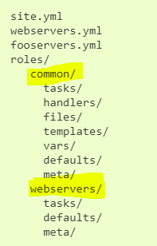
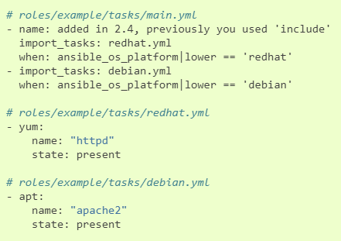
Roles
Roles are ways of automatically loading certain vars_files, tasks, and handlers based on a known file structure
Role Directory structure
tasks - contains the main list of tasks to be executed by the role.
handlers - contains handlers, which may be used by this role or even anywhere outside this role.
defaults - default variables for the role
vars - other variables for the role
files - contains files which can be deployed via this role.
templates - contains templates which can be deployed via this role.
meta - defines some meta data for this role. See below for more details.
Other YAML files may be included in certain directories

Slide 31
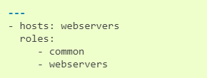
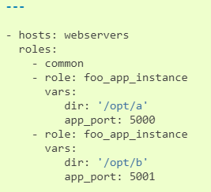
Roles
Using Roles
Roles can accept other keywords

Slide 32
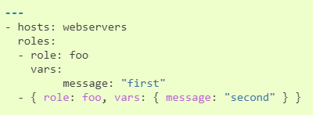
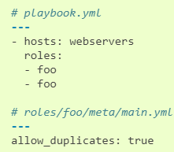
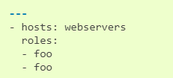
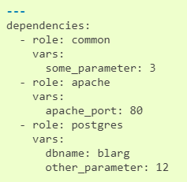
Roles
Roles duplicate execution
Executes once Executes twice Executes twice
Role Dependencies

Slide 33
Variables

Slide 34




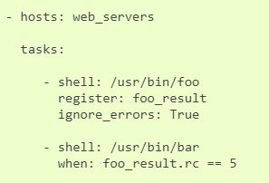
Variables
Valid variable name
Variable names should be letters, numbers, and underscores. Variables should always start with a letter.
Valid: foo_port, foo5
In Valid: foo-port, foo port, foo.port and 12
Get values of a variable
Invalid Valid
Information derived from system facts
Registered variables
Another major use of variables is running a command and using the result of that command to save the result into a variable

Slide 35
Variables
Passing variables on command line
Variable precedence
role defaults
inventory file or script group vars
inventory group_vars/all
playbook group_vars/all
inventory group_vars/*
playbook group_vars/*
inventory file or script host vars
inventory host_vars/*
playbook host_vars/*
host facts / cached set_facts
play vars
play vars_prompt
play vars_files
role vars (defined in role/vars/main.yml)
block vars (only for tasks in block)
task vars (only for the task)
include_vars
set_facts / registered vars
role (and include_role) params
include params
extra vars (always win precedence)

Slide 36
Variables
Variable Scopes
Global: this is set by config, environment variables and the command line
Play: each play and contained structures, vars entries (vars; vars_files; vars_prompt), role defaults and vars.
Host: variables directly associated to a host, like inventory, include_vars, facts or registered task outputs

Slide 37
Conditional Statements

Slide 38
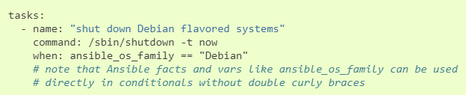
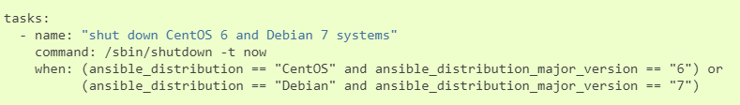
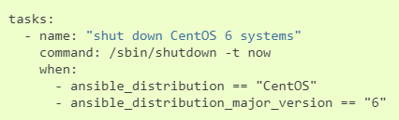
Conditional statements
When statement
Ex 1:
Ex 2: (logical or)
Ex3: (logical and)

Slide 39
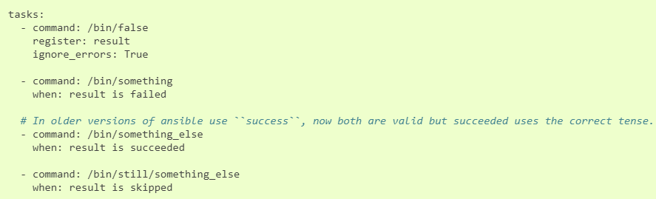



Conditional statements
Ex 4: (ignore error)
Ex 5: (convert str to int)
Ex 6: (Boolen variables)

Slide 40
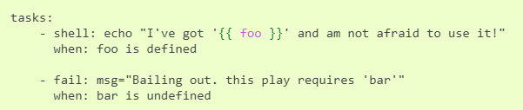

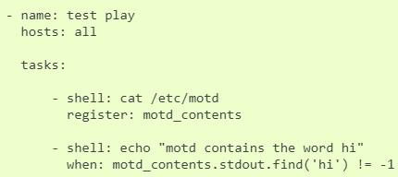
Conditional statements
Ex 7: (based on variable set )
Ex 8: (select a role)
Ex 9: (based on output of the command)

Slide 41
Loops

Slide 42
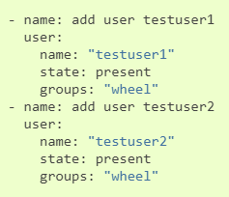
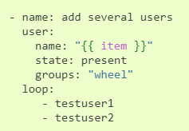
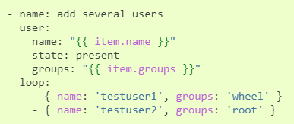
Loops
Standard loops
With out loops With loops, variables
With loops, hashes

Slide 43
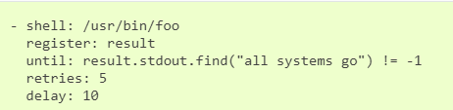
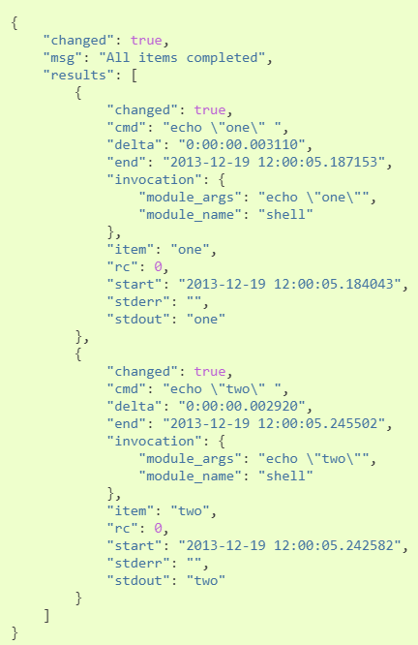
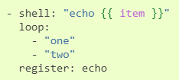
Loops
Do-Until loops
Using Register with loop
Code
Ouput

Slide 44
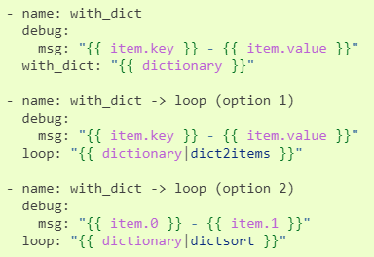
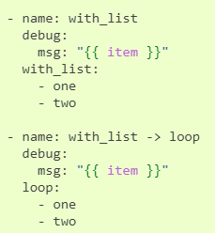
Loops
With_X loops
with_list
with_items
with_indexd_items
With_dict
Etc
with_list with_dict

Slide 45
Advanced Use cases

Slide 46
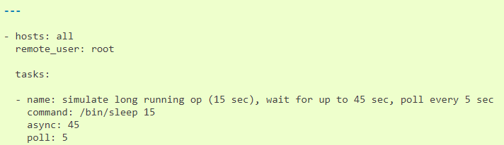
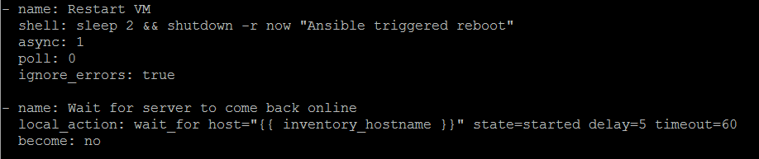
Advanced Playbooks Features
Asynchronous Actions and Polling
Restart VM & wait till VM back online

Slide 47



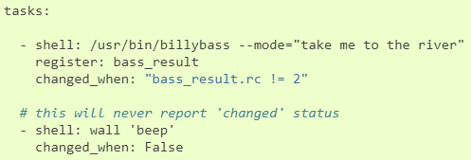
Advanced Playbooks Features
Error handling
Ignoring failed commands
Controlling what defines failure
Overriding changed result

Slide 48

Advanced Playbooks Features
Aborting the play

Slide 49
Questions ?

